Slide 1



HR ANALYTICS
GROUP - 3
P432

Slide 2

MEMBERS :-
1. Piyush Jaiswal
2. Brendan Almeida
3. Namrita Uchil
4. Tanushri Mune
5. Shabeel Khan
6. Vaibhav Tiwari
7. Ganesh Shingare

Slide 3
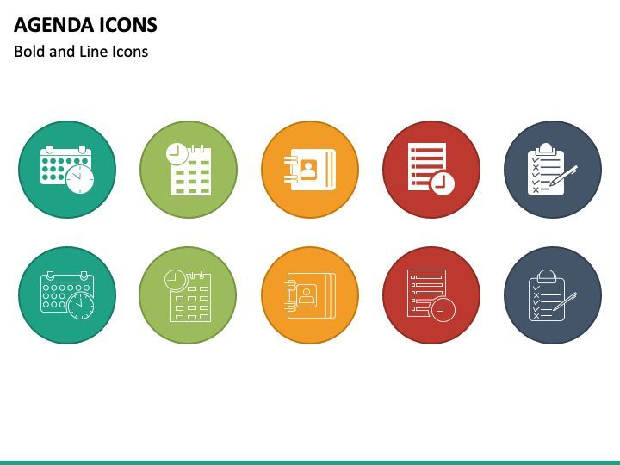
Agenda
Introduction
Problem Statements
KPI’s
Dashboards
Conclusion

Slide 4
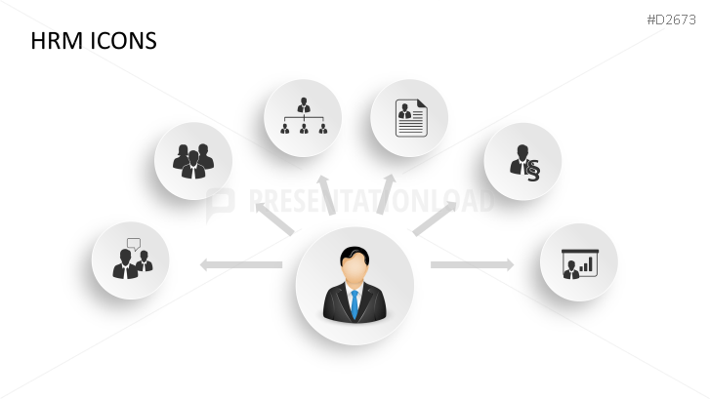
Introduction
HR analytics entails gathering and analysing HR data, like employee details and performance metrics, using advanced analytical tools. This process offers valuable insights into HR processes and trends, aiding organizations in making informed decisions about their employees and enhancing overall performance.

Slide 5

Problem Statement
Average Attrition Rate for all Departments
Average Hourly Rate of Male Research Scientist
Attrition Rate Vs Monthly Income Stats
Average Working Years for each Department
Job Role Vs Work Life Balance
Attrition Rate Vs Years Since Last Promotion

Slide 6
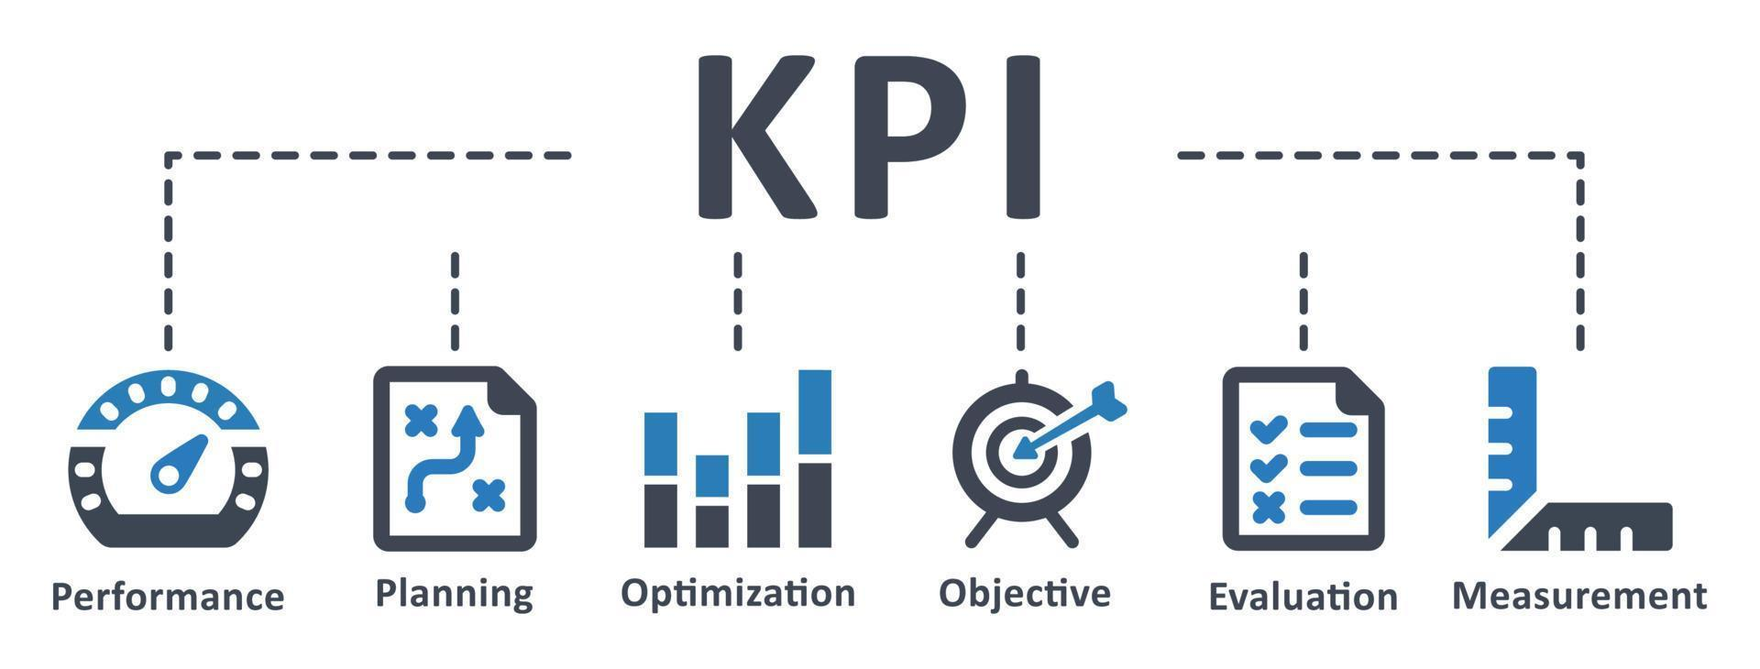
KPI’s

Slide 7
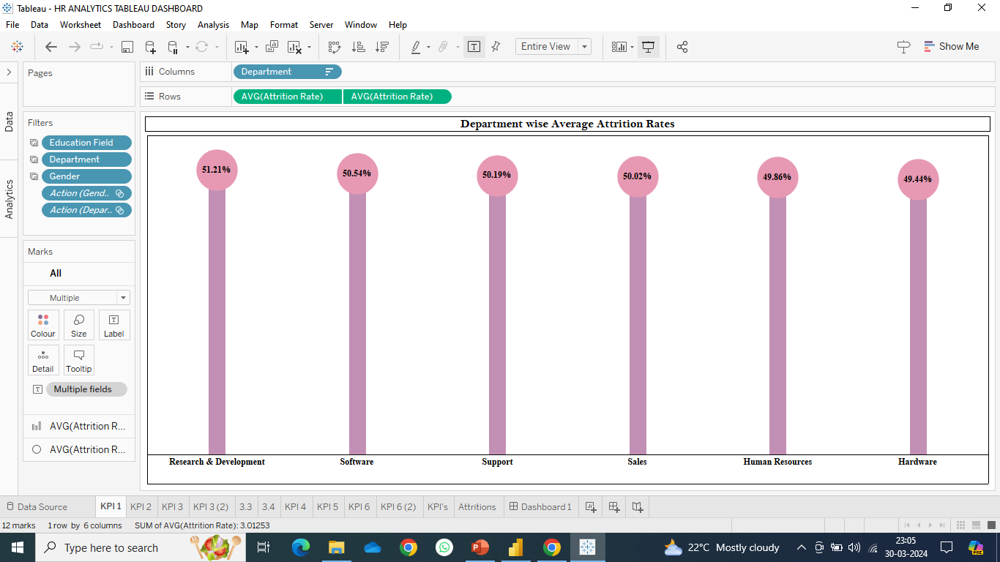
KPI 1 Average Attrition rate for all Departments
This key performance indicator (KPI) aims to examine the correlation between each department and its rate of attrition. Within this context, attrition refers to the turnover or departure of employees from the organization. The analysis reveals that the Research & Development Department experiences the highest attrition rate, while the Hardware Department records the lowest.

Slide 8
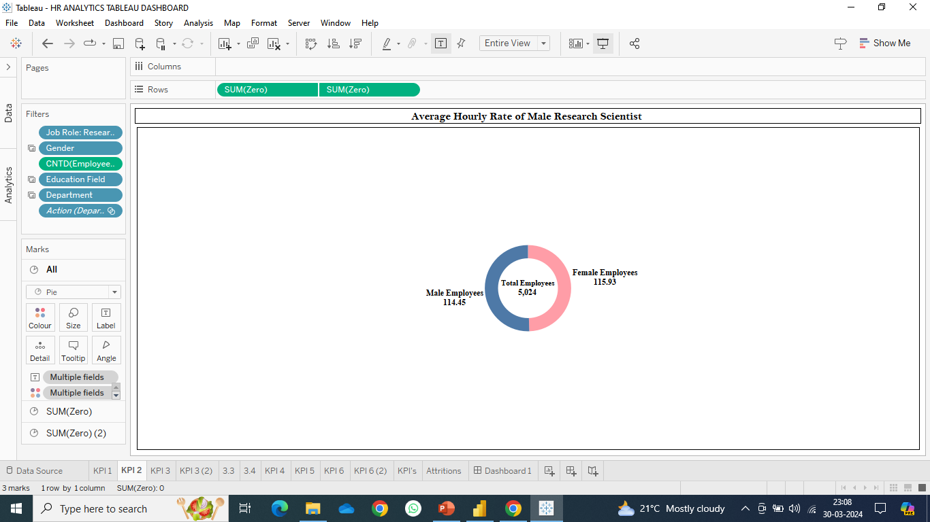
KPI 2 Average Hourly rate of Male Research Scientist
This KPI is to find out the average hourly rate of Male Research Scientists which is 114.45

Slide 9
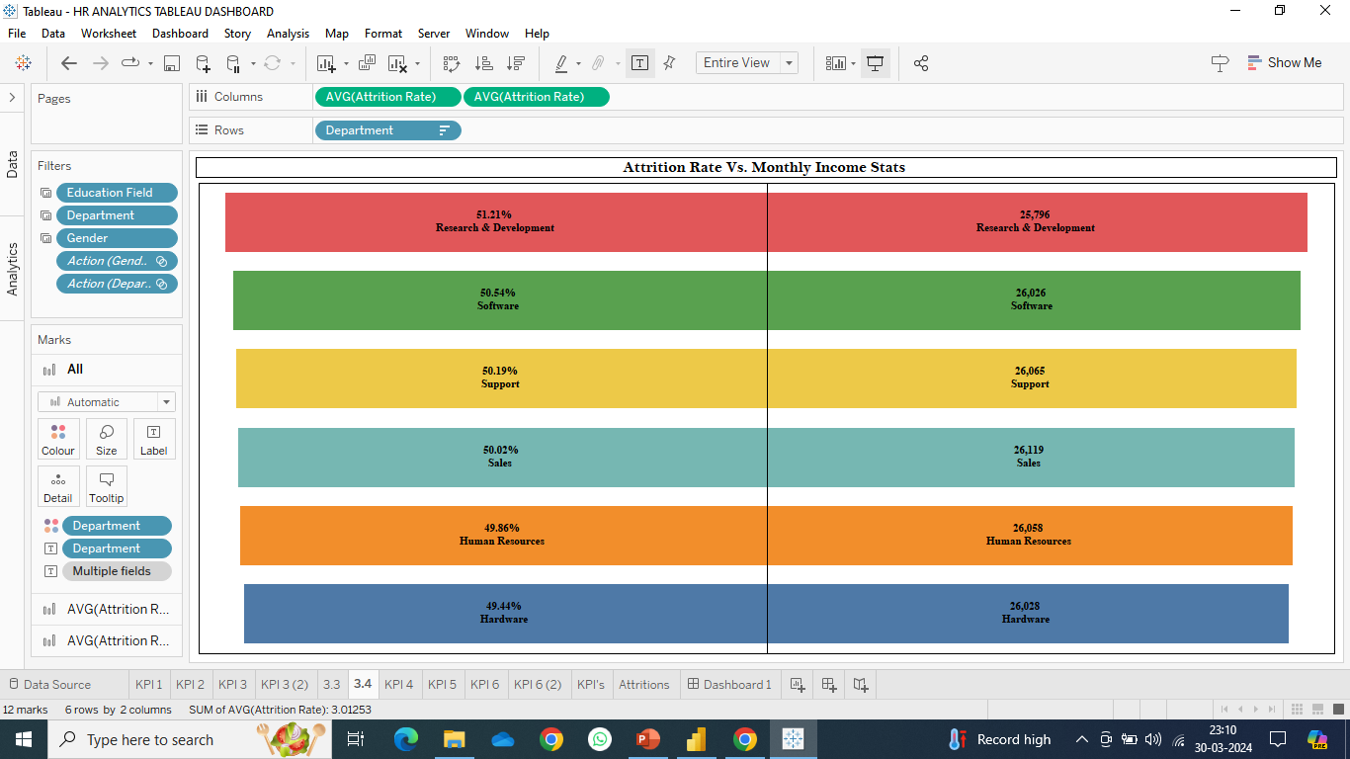
KPI 3 Attrition Rate Vs Monthly Income Stats
Our analysis and visualization clearly indicate that the Hardware Department boasts the lowest attrition rate at 49.44%, coupled with an average monthly income of Rs. 26,028. Conversely, the Research and Development Department exhibits the highest attrition rate, standing at 51.21%, alongside an average monthly income of Rs. 25,796.

Slide 10
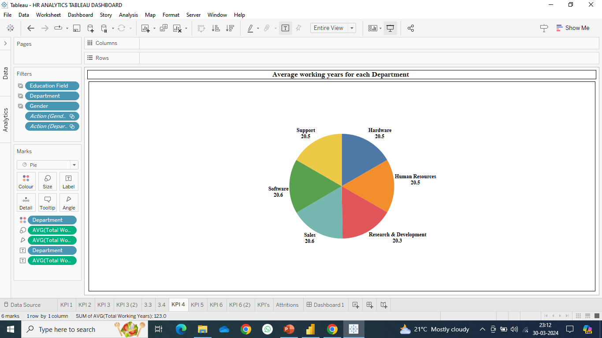
KPI 4 Average Working Years for each Department
This observation indicates that employees in the software department have, on average, a longer tenure compared to those in other departments. Conversely, the Research & Development Department has the lowest average tenure among all departments.
Based on the analysis, it can be inferred that the average tenure across all departments is approximately 20 years.

Slide 11
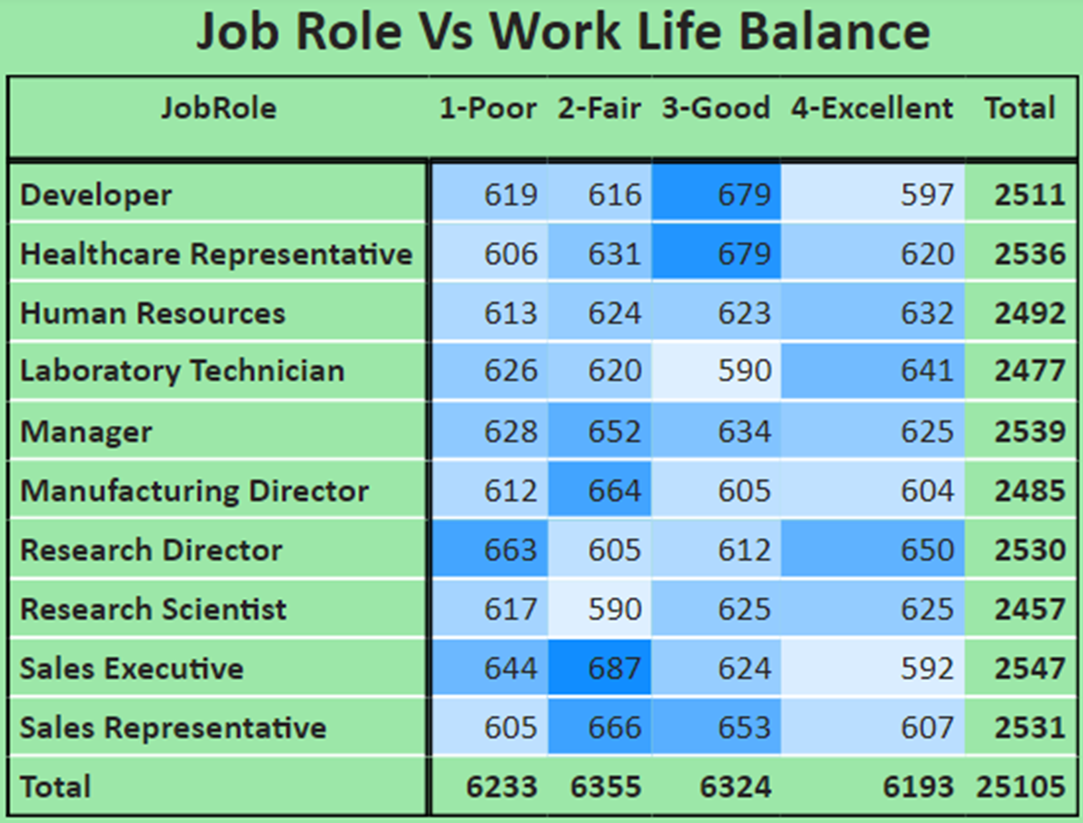
KPI 5 Job Role Vs Work Life Balance
Based on the analysis, several conclusions can be drawn regarding the work-life balance across different roles within the organization:
Research directors and laboratory technicians experience poor work-life balance.
Sales representatives, managers, manufacturing directors, and sales executives have a fair work-life balance.
Research scientists, healthcare representatives, and developers enjoy a good work-life balance.
Human resources professionals benefit from an excellent work-life balance.

Slide 12
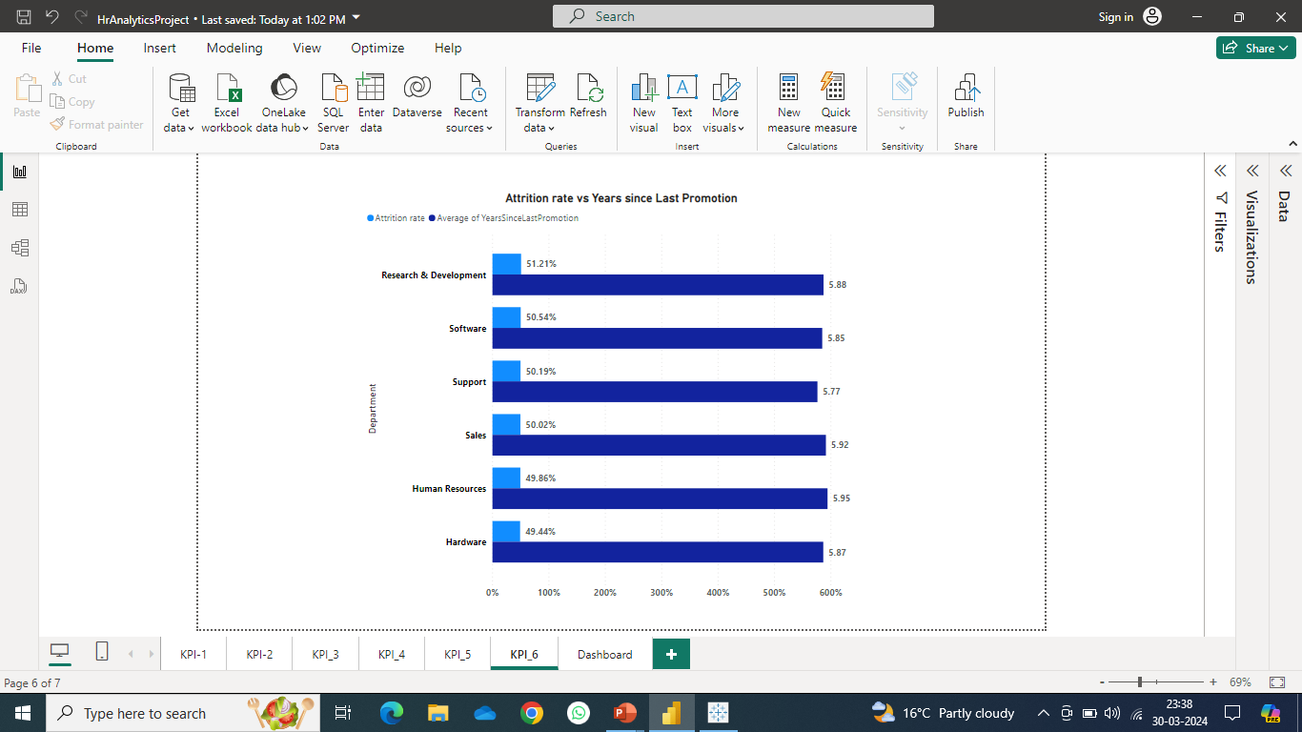
KPI 6 Attrition Rate Vs Years Since Last Promotion
In summary, the Research and Development department experiences a 51.21% attrition rate, with nearly 5.8 years passing since its last promotion.
Meanwhile, the HR department, with a 49.86% attrition rate, has gone almost 6 years without promotions.
Attrition rates are high in the research and development department but low in the hardware department.
Additionally, the support department shows more frequent promotions compared to the software and hardware departments.

Slide 13
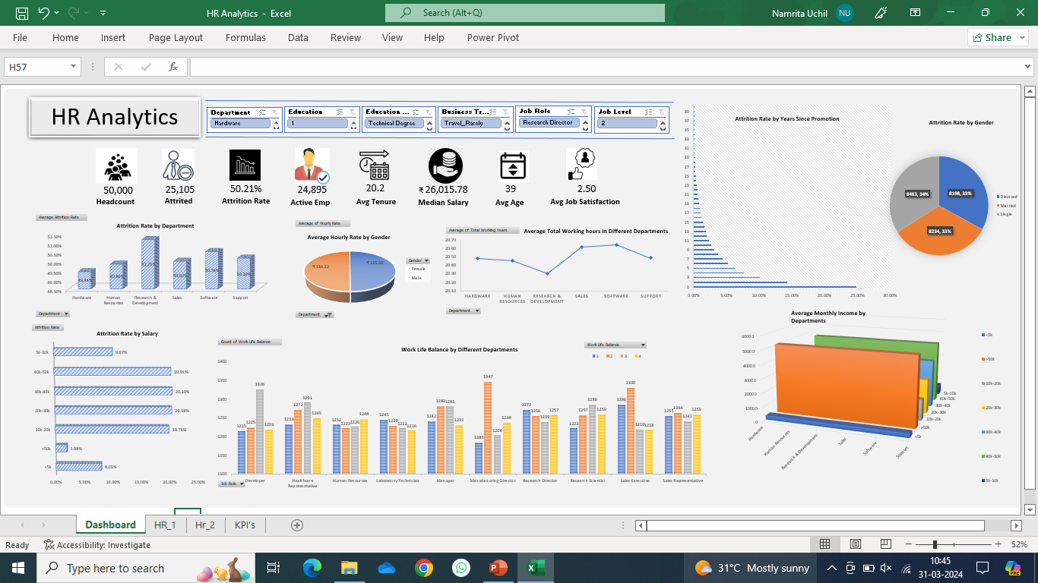
EXCEL DASHBOARD

Slide 14
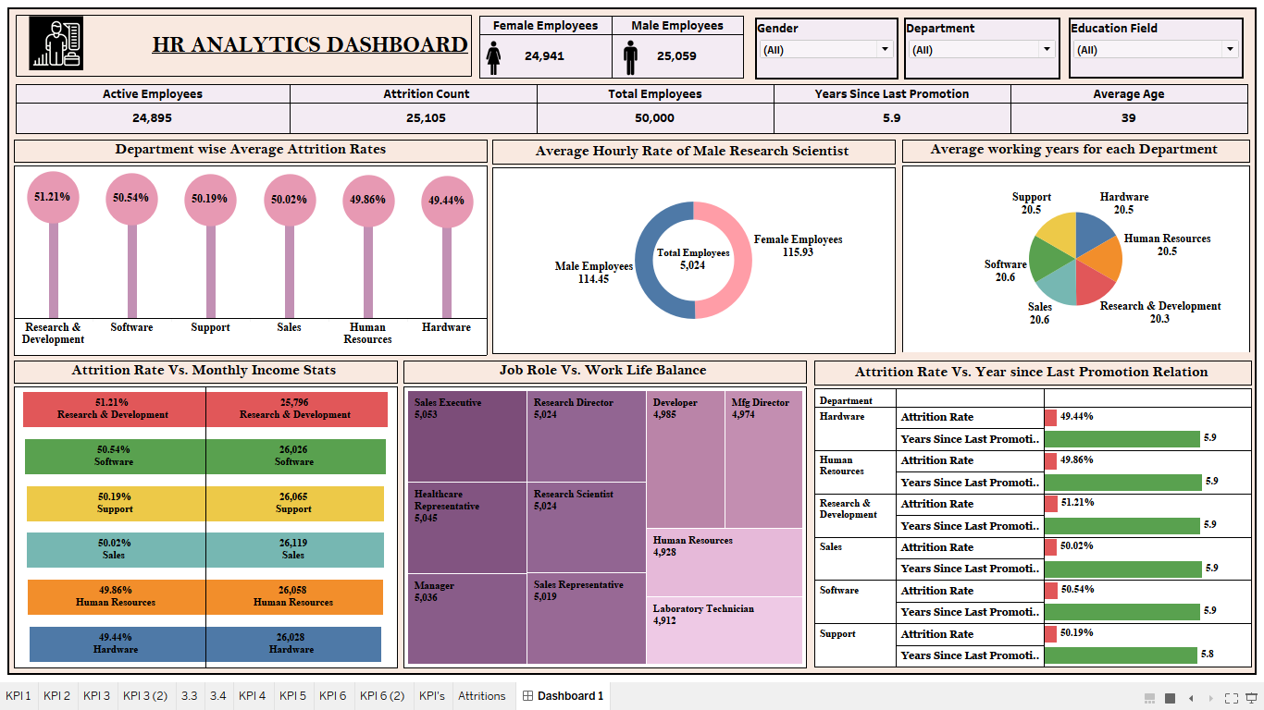
TABLEAU DASHBOARD

Slide 15
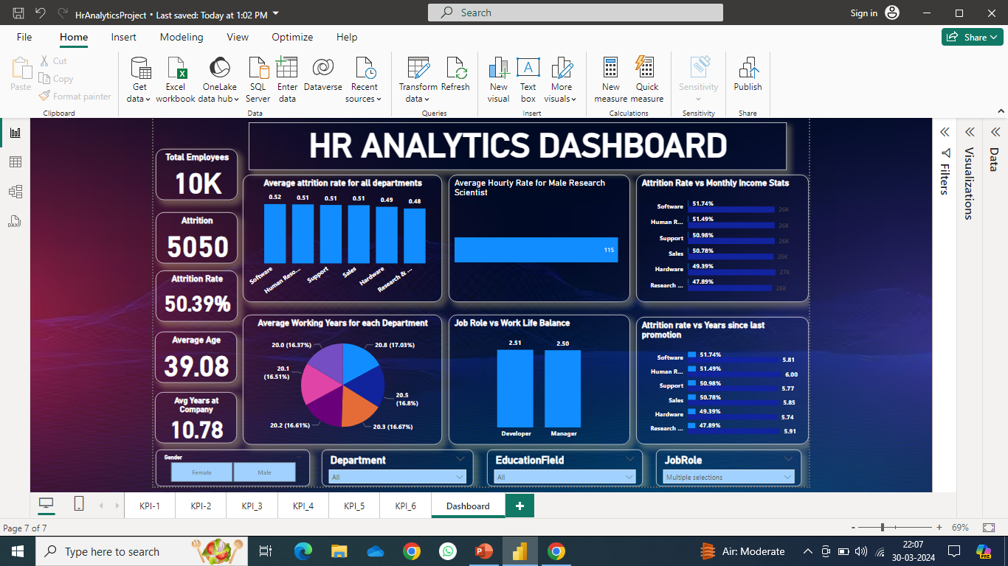
POWER BI DASHBOARD

Slide 16
Conclusion
In summary, prioritizing stay interviews over exit interviews enables organizations to proactively gather feedback from employees, facilitating a deeper understanding of their needs and concerns. By implementing strategies to improve employee engagement, address workload issues, foster a positive work environment, and ensure fair pay and compensation, organizations can cultivate a more supportive and fulfilling workplace culture. These efforts not only enhance employee satisfaction and retention but also contribute to overall organizational success and growth.

Slide 17
Thank you

